Slide 1
Childcare Choices: Partner communications toolkit July – September 2024

Slide 2
About Childcare Choices
Childcare Choices is a cross-government campaign that aims to make more parents aware of the financial support on offer to help them with the costs of childcare and to understand the offers in more detail.
From this September, 15 hours childcare will be expanded to eligible working parents with children aged 9 months old up to 3 years old. Parents can apply for this support by 31 August to start using it from 1 September.
Our communications activity until the end of August will focus on making sure as many eligible parents are aware of and apply for the 15 hours offer starting from September.
The Childcare Choices website helps parents to find out what they might be eligible for and when to apply. Parents can also sign up to the newsletter on the to receive updates and reminders.
We need your help
This communication toolkit contains information and resources about the next stage of the childcare support expansion from September. We need your help to share the Childcare Choices campaign with parents and carers.
Childcare entitlements to start in September 2024
Apply for | 15 hours childcare | 30 hours childcare
For | Children 9 months old up to 3 years old | Children 3 and 4 years old
Apply for your childcare code | On your childcare account on gov.uk
Apply for a code by | 31 August
Reconfirm your code | Every 3 months

Slide 3
5 ways you can inform parents about the childcare support
Share the Childcare Choices website with parents and let them know it helps them find the right offers of childcare support in one place. They can also use the website to check which support they might be eligible for.
Encourage parents to sign up to the Childcare Choices newsletter to receive updates and key information about government childcare support.
Use the templates and resources included in this toolkit to promote the campaign across your channels.
Help us inspire more parents to access the offers by bringing their stories to life. If you know parents who might be willing to share their childcare experience with us, please contact childcare.choices@education.gov.uk
Share our social media posts about the campaign from the @DfE, @DWP, and @HMRC accounts:
DfE: Facebook, X (Twitter), Instagram
DWP: Facebook, X (Twitter), Instagram
HMRC: Facebook, X (Twitter) , Instagram
If you have any questions or comments about the campaign, please contact: childcare.choices@education.gov.uk
Thank you for your support!

Slide 4
Templates and resources

Slide 5
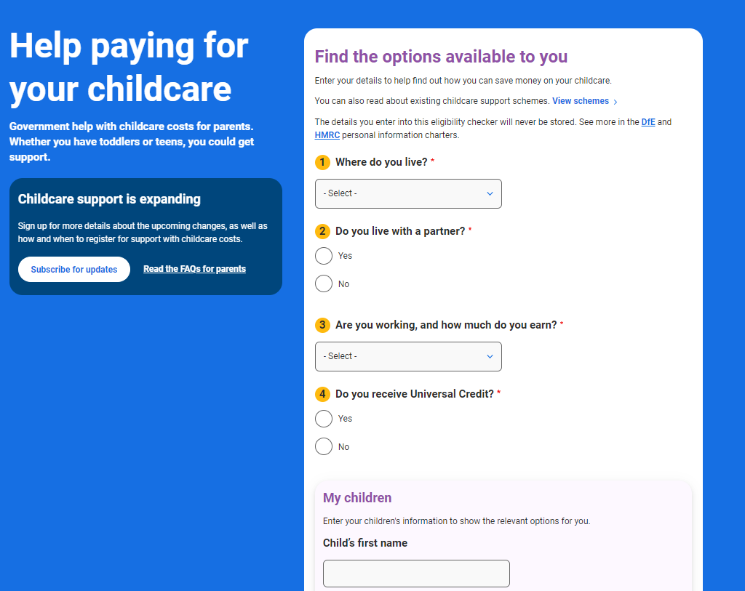
Explaining the changes to parents for September
An online childcare eligibility checker is available to help parents find the right childcare offer for them and learn how much money they can save.
Read the FAQs for parents to learn more about eligibility criteria, deadlines, and the application process.
Watch our video on YouTube with early years educator, Steff, explaining how parents can get their childcare code.
Share this short video on your social and digital channels to remind parents about the deadline to get their code for September.
Subscribe to our Education Hub for updates when new childcare and early years blogs are published. Visit the childcare section on the Hub to read the latest blogs.
Content is available to share on social channels, including X, Facebook, LinkedIn and Instagram.

Slide 6
Newsletter copy
This copy can be used to share key messages with parents in newsletters and e-mails:
Apply for 15 or 30 hours childcare to start a place in September
If you are an eligible working parent in England, you can now apply for:
15 hours childcare for your child aged 9 months old until they turn 3 years old
30 hours childcare for your 3 or 4 year old
You will need to apply by 31 August to use your hours from 1 September. To do so, visit gov.uk to get your code for a place in September and then share it with your childcare provider. To continue receiving the government support, you will need to reconfirm your details every 3 months on your gov.uk childcare account.
If you already use 15 hours for your 2-year-old and they then turn 3 years old and become eligible for 30 hours, the code for 15 hours will be the same as the one for 30 hours. You can reconfirm as normal when you are able to on your childcare account on gov.uk, and the code will be valid for the 30 hours offer.
Make sure you speak to your provider to find out more about their arrangements.
This comes alongside other already existing government childcare support, including 30 hours childcare for 3 and 4 year olds, Tax-Free Childcare and Universal Credit Childcare. You might be able to use more than one offer together to help with your childcare costs.
Visit Childcare Choices to see what support you might be eligible for: Childcare Choices | 30 Hours Childcare, Tax-Free Childcare and More | Help with Costs | GOV.UK

Slide 7
How to get your childcare code for September
Share this step-by-step guide with parents for them to learn more about how to apply for a childcare code:
Here’s how to get your childcare code:
1. Check your eligibility online on the Childcare Choices website.
2. Speak to your provider, such as your nursery or childminder. Check what their arrangements are and that they can offer your child a place.
3. Create a childcare account on gov.uk if you don’t already have one, where you can apply for your code. You’ll need:
your National Insurance Number (or unique taxpayer reference if you are self-employed)
the date you started or are due to start work
details of any government support or benefits you receive
the UK birth certificate reference number (if you have one) for your child
4. You may receive your code straight away, but it can take up to 7 days. You should then give this code to your provider.
5. Reconfirm your details on your gov.uk childcare account every 3 months.
If you have already applied for your code to start in September and received it before 1 June, you may need to reconfirm your details before you take up a place in September. Log into your childcare account on gov.uk to check when you need to do so.
If you needed to reconfirm your details for Tax-Free Childcare before 12 May and your reconfirmation window opened after 9 June, you will have received a letter from HMRC with a valid temporary code.
To learn more, watch this video with nursery staff Steff explaining the application process.

Slide 8
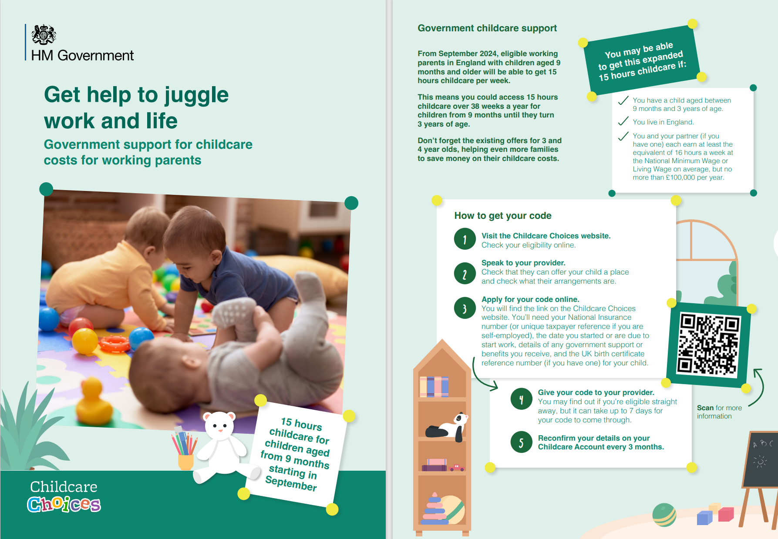
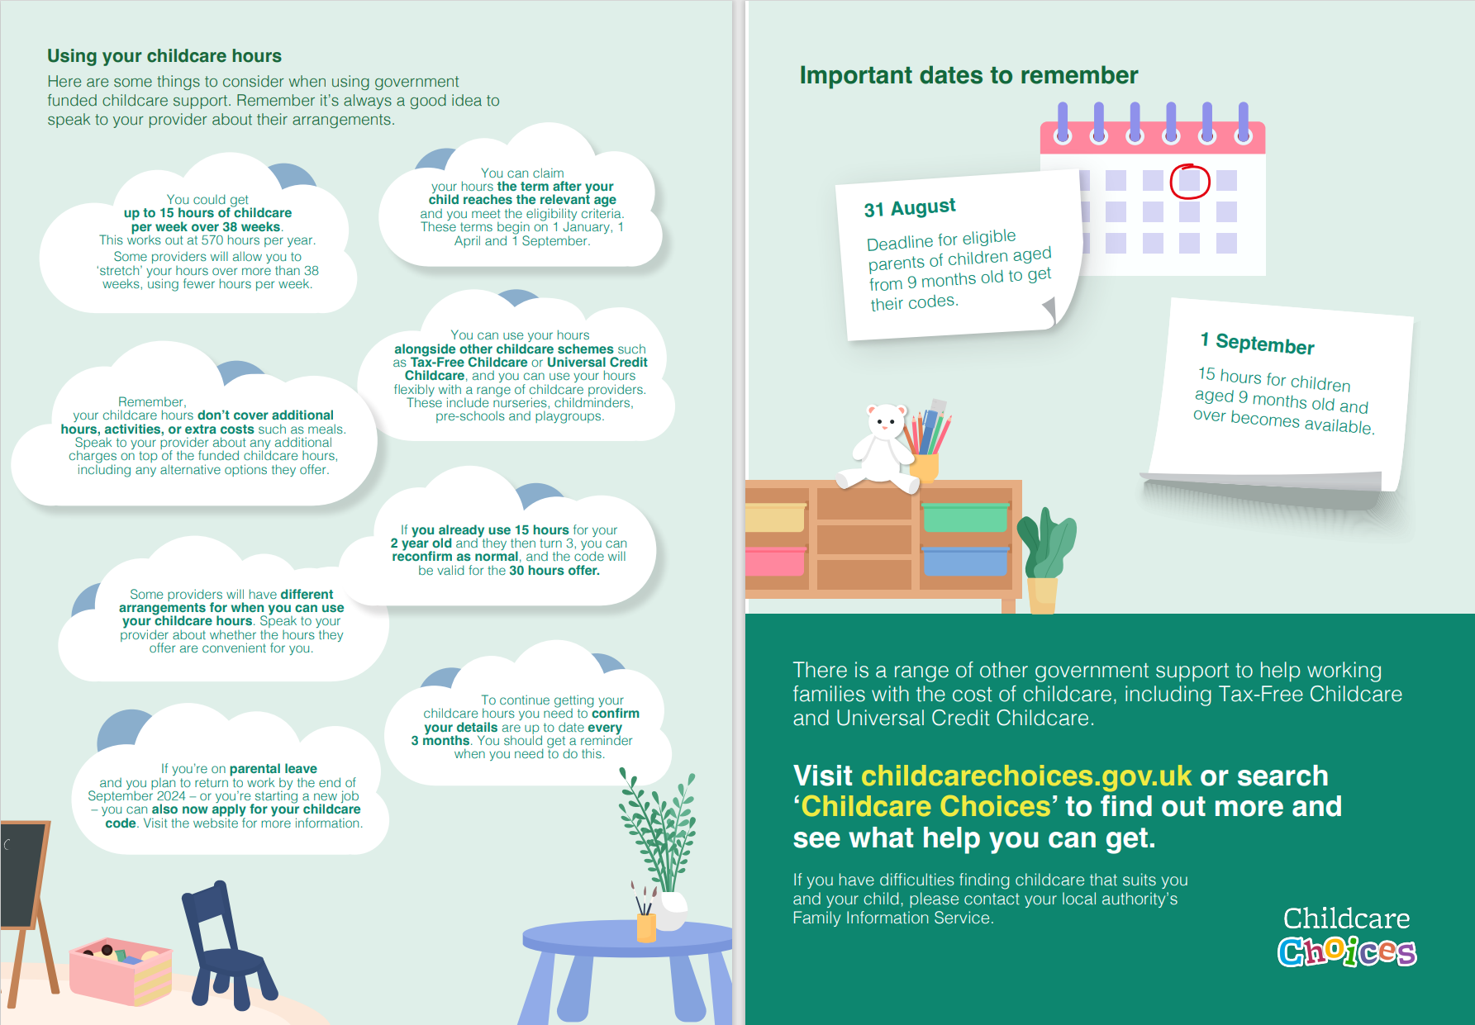
NEW: Leaflet
Download or print out the leaflet for your channels here.
Both digital and ready to print versions are available.

Slide 9
Sample social media posts: 15 hours childcare
Let parents know that more childcare support is on the way from September and that they can apply by 31 August if they are eligible. Here are some graphics and suggested accompanying messages that you can edit and use on your own channels to spread the word. You can tag us using #ChildcareChoices.
1
2
3
4
Thousands of 2-year-olds in England accessed 15 hours childcare from April. This is the first phase of the childcare support expansion.
This offer is expanding to eligible working parents of children aged 9 months old. Apply for your childcare code by 31 August to start a place in September.
Visit the Childcare Choices website to check what support you might be eligible for 👇
www.childcarechoices.gov.uk
From September, even more working parents will have access to childcare for their children.
If you are an eligible working parent with a child who is or turns at least 9 months old by 31 August, you can now apply for 15 hours childcare to start in September.
Stay up to date with the upcoming expansion to childcare support with our regular newsletter for parents 👇
www.childcarechoices.gov.uk
Did you know you can use 15 hours childcare alongside Tax-Free Childcare or Universal Credit Childcare?
If you are an eligible working parent with a child who is or turns at least 9 months old on or before 31 August, you can now apply for 15 hours childcare to start in September.
Remember to check your details on your gov.uk account are up to date every 3 months.
Check out what support fits your family 👇
www.childcarechoices.gov.uk
Are you a working parent who earns less than £100k per year and has a child who is at least 9 months old?
From September, you might be eligible to access 15 hours childcare support for your child. Apply for your code online on gov.uk by 31 August.
Visit Childcare Choices to check what support you might be eligible for and how to apply 👇
www.childcarechoices.gov.uk
Social media graphic:
Social media graphic:
Social media graphic:
Social media graphic:
Download graphics, videos, and case studies for your channels here

Slide 10
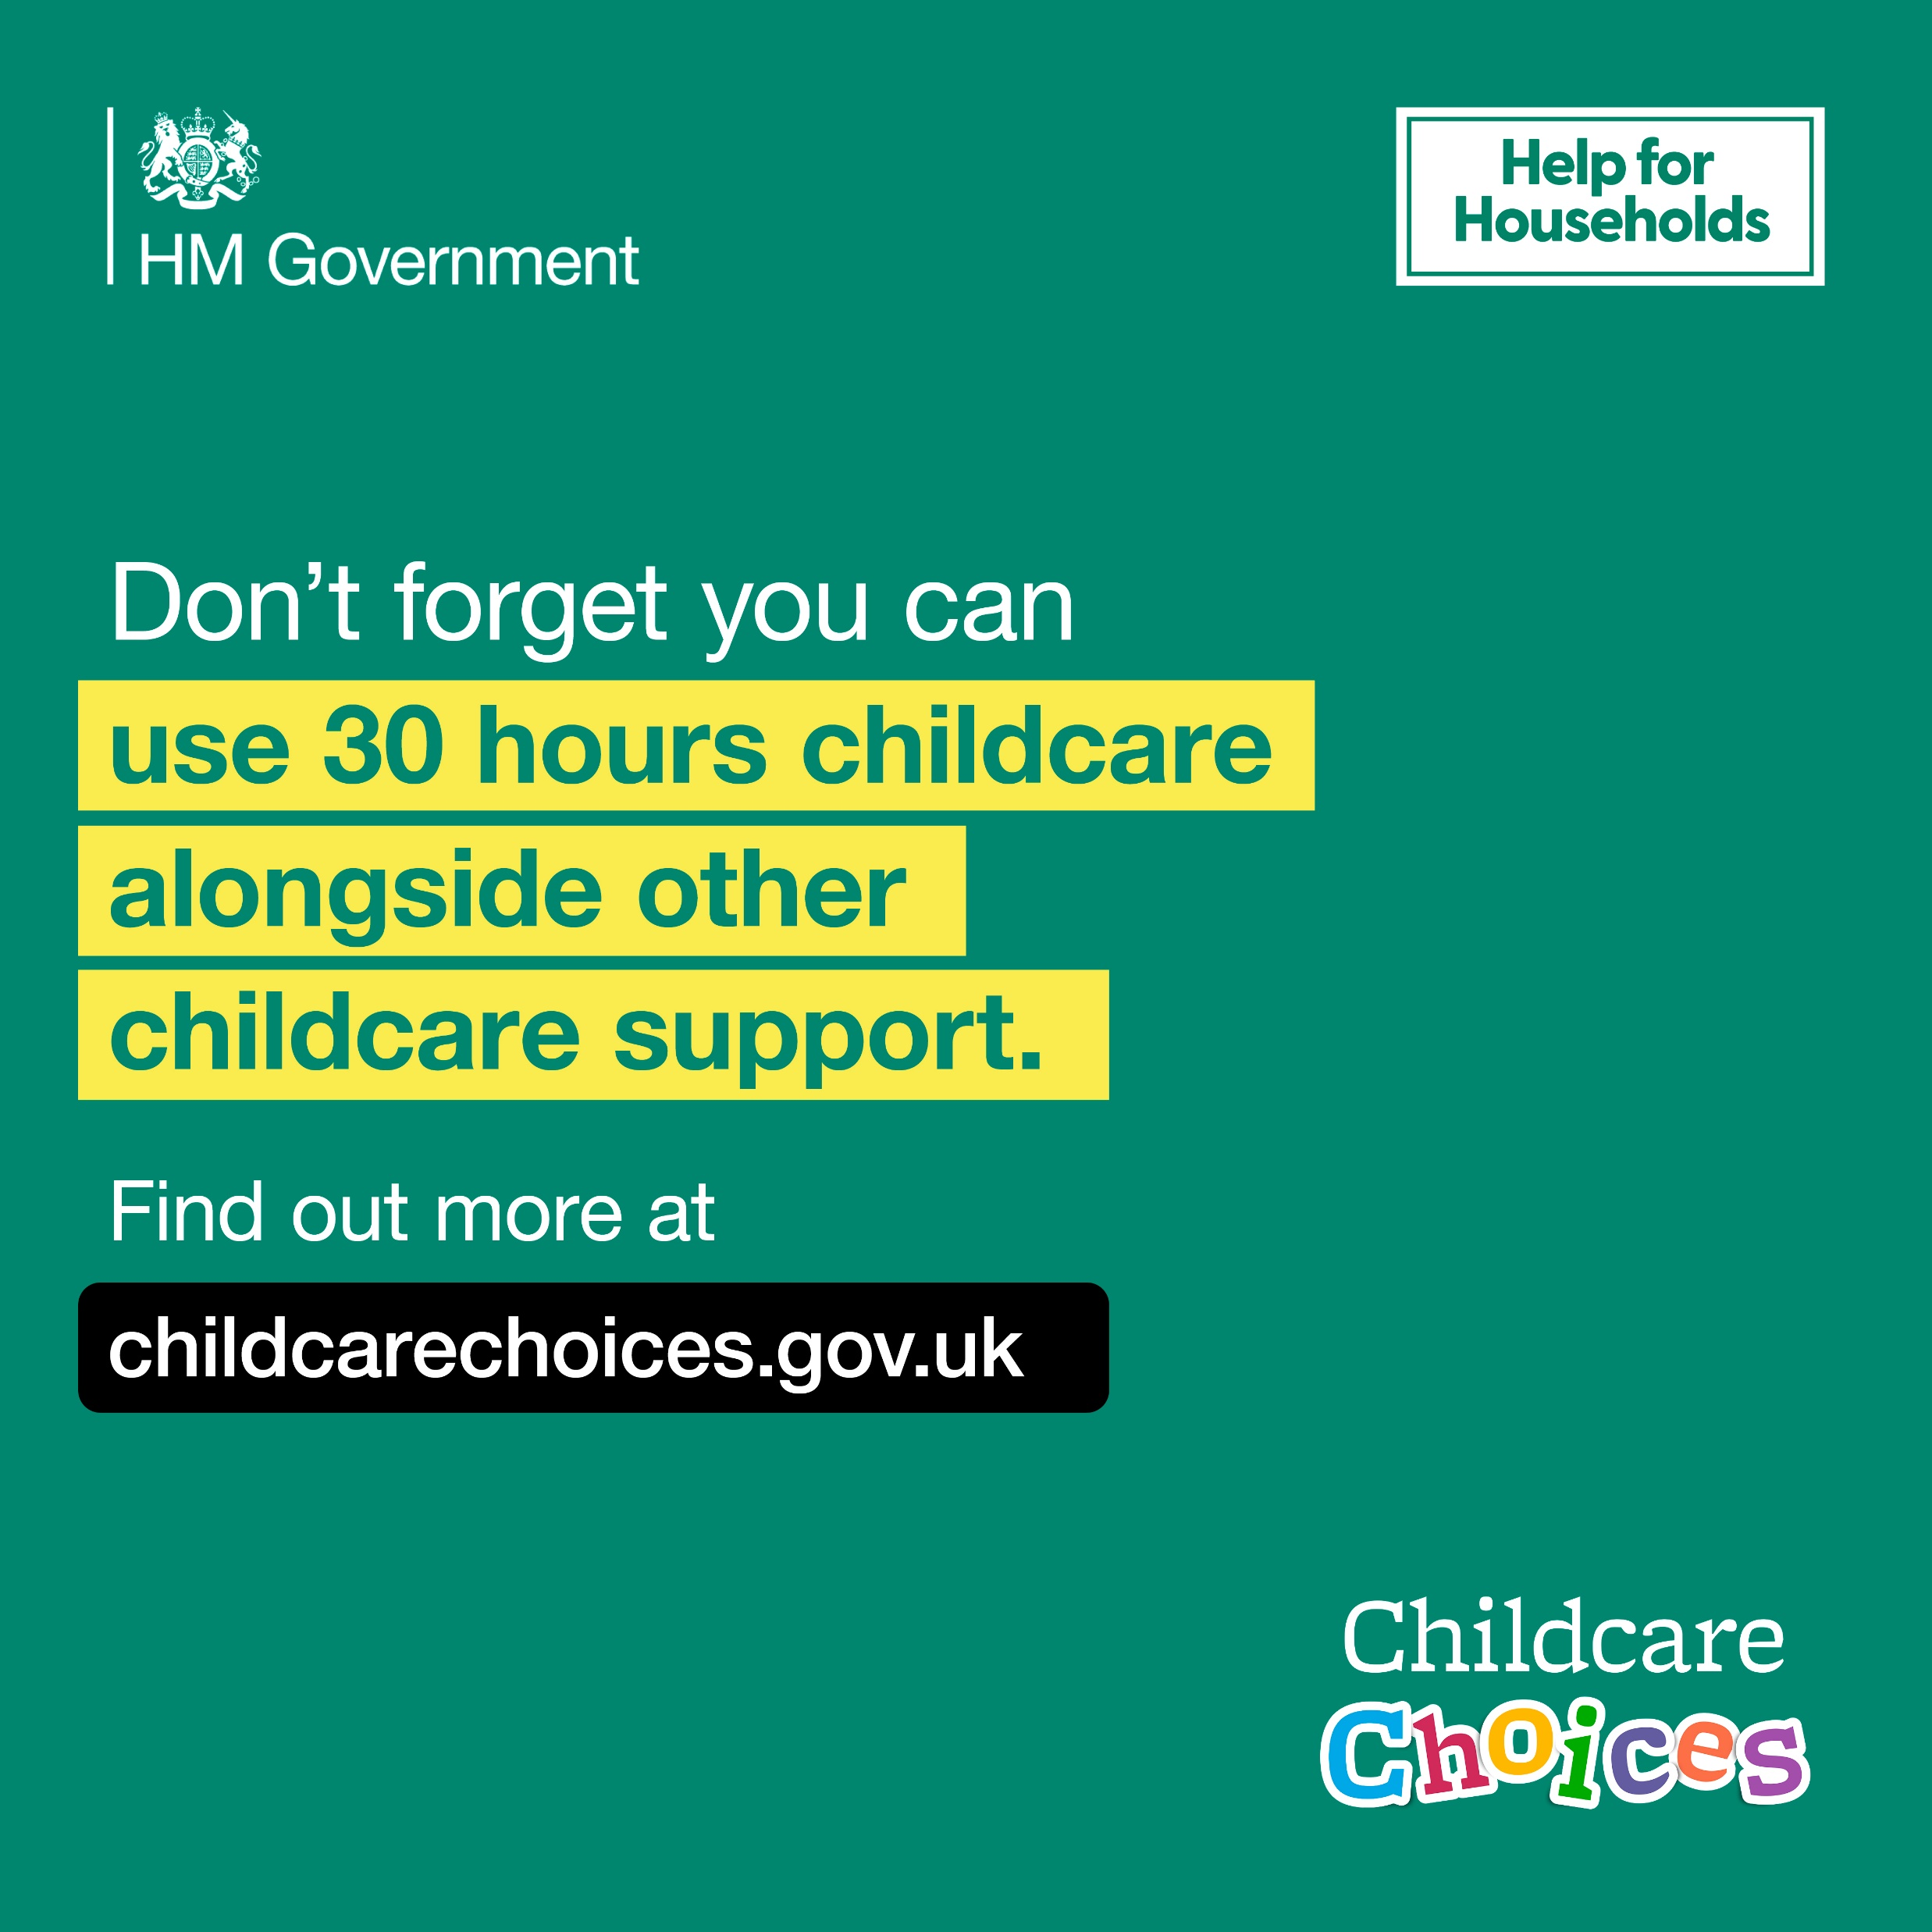
Sample social media posts: 30 hours childcare
Remind working parents that they will get their 30 hours the term after their child is 3, if they've received their code through the Childcare Service. They need to apply by 31 August to take up a place from September. Parents also need to check their Childcare Account details every 3 months to reconfirm their details to keep using 30 hours. You can tag us using #ChildcareChoices.
1
2
3
4
📢 You could be eligible for 30 hours childcare without realising!
Here at “enter name” we are set up so our families can access all the different types of government childcare support.
Don’t miss out on help with your childcare costs - find out which offer is right for you 👇
www.childcarechoices.gov.uk/
📢 Did you know you can use Tax-Free Childcare whilst you’re using 30 hours?
Here at “enter name” we are set up so our families can access all the different types of government childcare support.
Get help that fits your family - find out which offer is right for you: www.childcarechoices.gov.uk/
📢 Have you applied for your code yet for 30 hours childcare?
You need to apply by 31 August to take up a place from September.
Remember to check your details are up to date every 3 months.
Find out more at www.childcarechoices.gov.uk/
📢 Did you know you can use your 30 hours at up to two different providers per day?
You can use them flexibly with a range of childcare providers such as:
Nurseries
Childminders
Preschools
Try the online checker to find out which offer is right for you: www.childcarechoices.gov.uk/
Social media graphic
(post copy for childcare providers):
Social media graphic
(post copy for childcare providers):
Social media graphic:
Social media graphic:
Download graphics, videos, and case studies for your channels here

Slide 11
Sample social media posts: Tax-Free Childcare
Tax-Free Childcare can unlock thousands of pounds of support for your families, remind your parents this support can be used alongside 30 hours. It can also be used for children up to 11 or 16 if disabled. Here are some graphics and suggested accompanying messages, that you can edit, to explain Tax-Free Childcare to parents and carers. You can tag us using #ChildcareChoices.
1
2
3
4
Want up to £2,000 a year for each child, to help with the costs of childcare?
Don’t miss out on Tax-Free Childcare next term. Visit 👇
www.childcarechoices.gov.uk/
Claiming Tax-Free Childcare means up to £2,000 a year, to help cover the cost of
(provider to insert relevant offer e.g.):
🍽️ breakfast clubs
🧒 nurseries
🎨 after-school clubs
Visit 👇
www.childcarechoices.gov.uk/
Does your child go to our before and after school clubs? Or go to a sports or holiday club?
Open a Tax-Free Childcare account for help with costs.
Visit 👇
www.childcarechoices.gov.uk/
We know childcare isn't just for toddlers, so Tax-Free Childcare can help you cover costs of childcare for children up to 11, or 16 for children with a disability.
Don’t miss out on what you’re entitled to, visit www.childcarechoices.gov.uk/
Social media graphic:
Social media graphic:
Social media graphic:
Social media graphic:
Download graphics, videos, and case studies for your social channels here

Slide 12
Sample social media posts: Universal Credit Childcare
Once childcare providers have registered with the relevant regulator, working parents on Universal Credit can claim back up to 85% of their childcare costs and receive as much as £1,015 per month for one child or £1,739 for two or more children. There is support available for parents who might need it to pay their costs upfront. Help us to inform parents and guardians on Universal Credit about this support with the following graphics and suggested accompanying messages that you can edit and use on your own channels. You can tag us using #ChildcareChoices.
1
2
3
If you are a working parent and claiming Universal Credit, you could get help with up to 85% of your childcare costs. with Universal Credit, depending on your income.
Find out more at www.childcarechoices.gov.uk/
Looking to fit work around your family? Universal Credit can help provide support with childcare costs.
Find out more at www.childcarechoices.gov.uk/
Parents, additional help with initial childcare costs is available with Universal Credit when you enter work or increase your hours.
Find out more at www.childcarechoices.gov.uk/
Social media graphic:
Social media graphic:
Social media graphic:
Download graphics, videos, and case studies for your social channels here

Slide 13
Short messages to use on images
If you want to create your own images to support the campaign and spread the word about the childcare support, you can add the below key messages to your images and use them across your social and digital channels.
In some cases, you might find it useful to combine one message in the first box with one from the second box.
You can use all the below messages with our campaign call to action: Visit childcarechoices.gov.uk to find out more.
You can tag us in your post copy using #ChildcareChoices.
The September offer
Eligibility & application process
(good for carousel post or infographic)
Apply now for 15 or 30 hours childcare for September.
Remember to apply for your childcare code for September by 31 August.
You’ve got until 31 August to get your 15 hours code for children aged 9 months old and over.
You’ve got until 31 August to get your 30 hours code for your 3 or 4 year old.
Do you have a child between 9 months old and three years old? You might be eligible for 15 hours childcare.
Do you have a 3 or 4 year old? You might be eligible for 30 hours childcare
Get your 15 hours childcare code to start in September
15 hours childcare for children aged 9 months and over
Apply now for 15 hours childcare for 9 month olds
From September, 15 hours childcare for children aged 9 months and over
Find out if you are eligible for 15 hours childcare from September.
Check your eligibility on childcarechoices.gov.uk.
Speak to your preferred provider about their arrangements.
Apply for your code online on gov.uk by 31 August.
Give your code to your childcare provider.
Reconfirm your details every 3 months on your gov.uk account to keep receiving the support.

Slide 14
Childcare support offers

Slide 15
Childcare support expansion offer (to date)
From April 2024:
15 hours childcare – Age 2
(✓ already rolled out and continuing)
From September 2024:
15 hours childcare -
Ages 9 - 23 months
(apply before 31 August)
For eligible working families in England.
Each parent earning at least the equivalent of 16 hours/week at national minimum wage but under £100,000 adjusted net income/year.
With a 2-year-old child (turning 2 on or before 31 March).
15 hours of childcare or early education for 38 weeks.
A total of 570 hours per year, that you can use flexibly with one or more childcare providers.
For eligible working families in England.
Each parent earning at least the equivalent of 16 hours/week at national minimum wage but under £100,000 adjusted net income/year.
With a child between 9 and 23 months old.
15 hours of childcare or early education for 38 weeks.
A total of 570 hours per year, that you can use flexibly with one or more childcare providers.

Slide 16
Existing childcare support packages - 1/2
The eligibility criteria of the different forms of government childcare support packages that parents can access are as follows:
Tax-Free Childcare
Universal Credit Childcare
For working families, including the self-employed, in the UK
Earning under £100k and at least £183 per week (equal to 16 hours at the National Minimum or Living Wage) each
Who aren't receiving Tax Credits, Universal Credit or childcare vouchers
With children aged 0-11 (or 0-16 if disabled)
For every £8 they pay into an online account, the government will add an extra £2, up to £2,000 per child per year (or up to £4,000 per child if disabled)
Can be accessed through your registered providers and childminders who have activated their Tax-Free Childcare accounts.
For working families claiming Universal Credit, in England, Scotland, and Wales. Northern Ireland has separate arrangements. Eligibility criteria apply
Both parents working – unless one of the allowable exceptions is met
With children usually under 17 (including disabled)
Up to 85% of eligible childcare costs can be reclaimed
Upfront support is available to fund your first month’s payment. Ask your work coach for more information
Tax-Free Childcare is not available if also claiming Working Tax Credit, Child Tax Credit, Universal Credit or childcare vouchers
Can be accessed through registered providers or childminders.

Slide 17
Parents might be eligible to use more than one childcare schemes together.
Find out more from the Childcare Choices website.
Existing childcare support packages - 2/2
15 hours childcare –
Age 2 receiving additional government support
15 hours childcare - Ages 3 & 4
30 hours childcare –
Ages 3 & 4
For families in England, receiving some forms of additional government support. Visit GOV.UK for further information.
With 2-year-old children
15 hours of childcare or early education for 38 weeks
A total of 570 hours per year, that they can use flexibly with one or more childcare provider
If you are a childcare provider, speak to your local authority if you are interested in delivering the entitlements.
For all families in England with 3 and 4-year-old children
15 hours of childcare or early education for 38 weeks
A total of 570 hours per year, that they can use flexibly with one or more childcare provider
If you are a childcare provider, speak to your local authority if you are interested in delivering the entitlements.
For working families in England with 3 and 4-year-old children
Each parent earning at least the equivalent of 16 hours/week at national minimum wage but under £100,000 adjusted net income/year
30 hours of childcare or early education for 38 weeks
A total of 1,140 hours per year, that they can use flexibly with one or more childcare provider
If you are a childcare provider, speak to your local authority if you are interested in delivering the entitlements.

